Slide 1
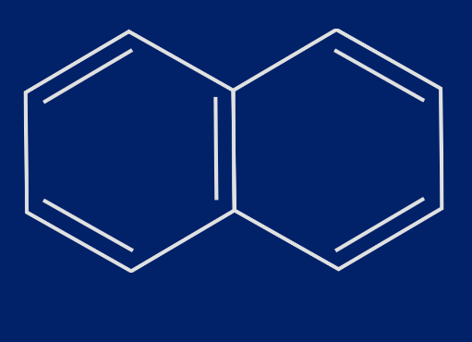
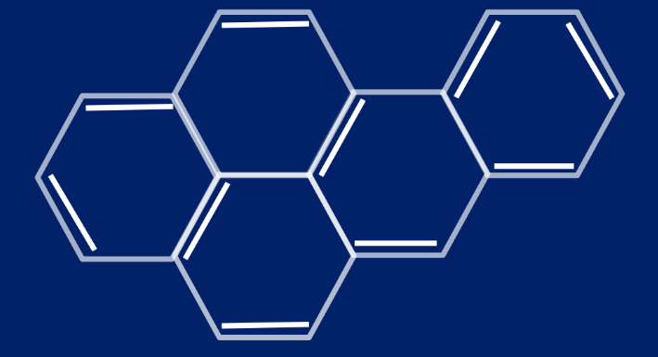
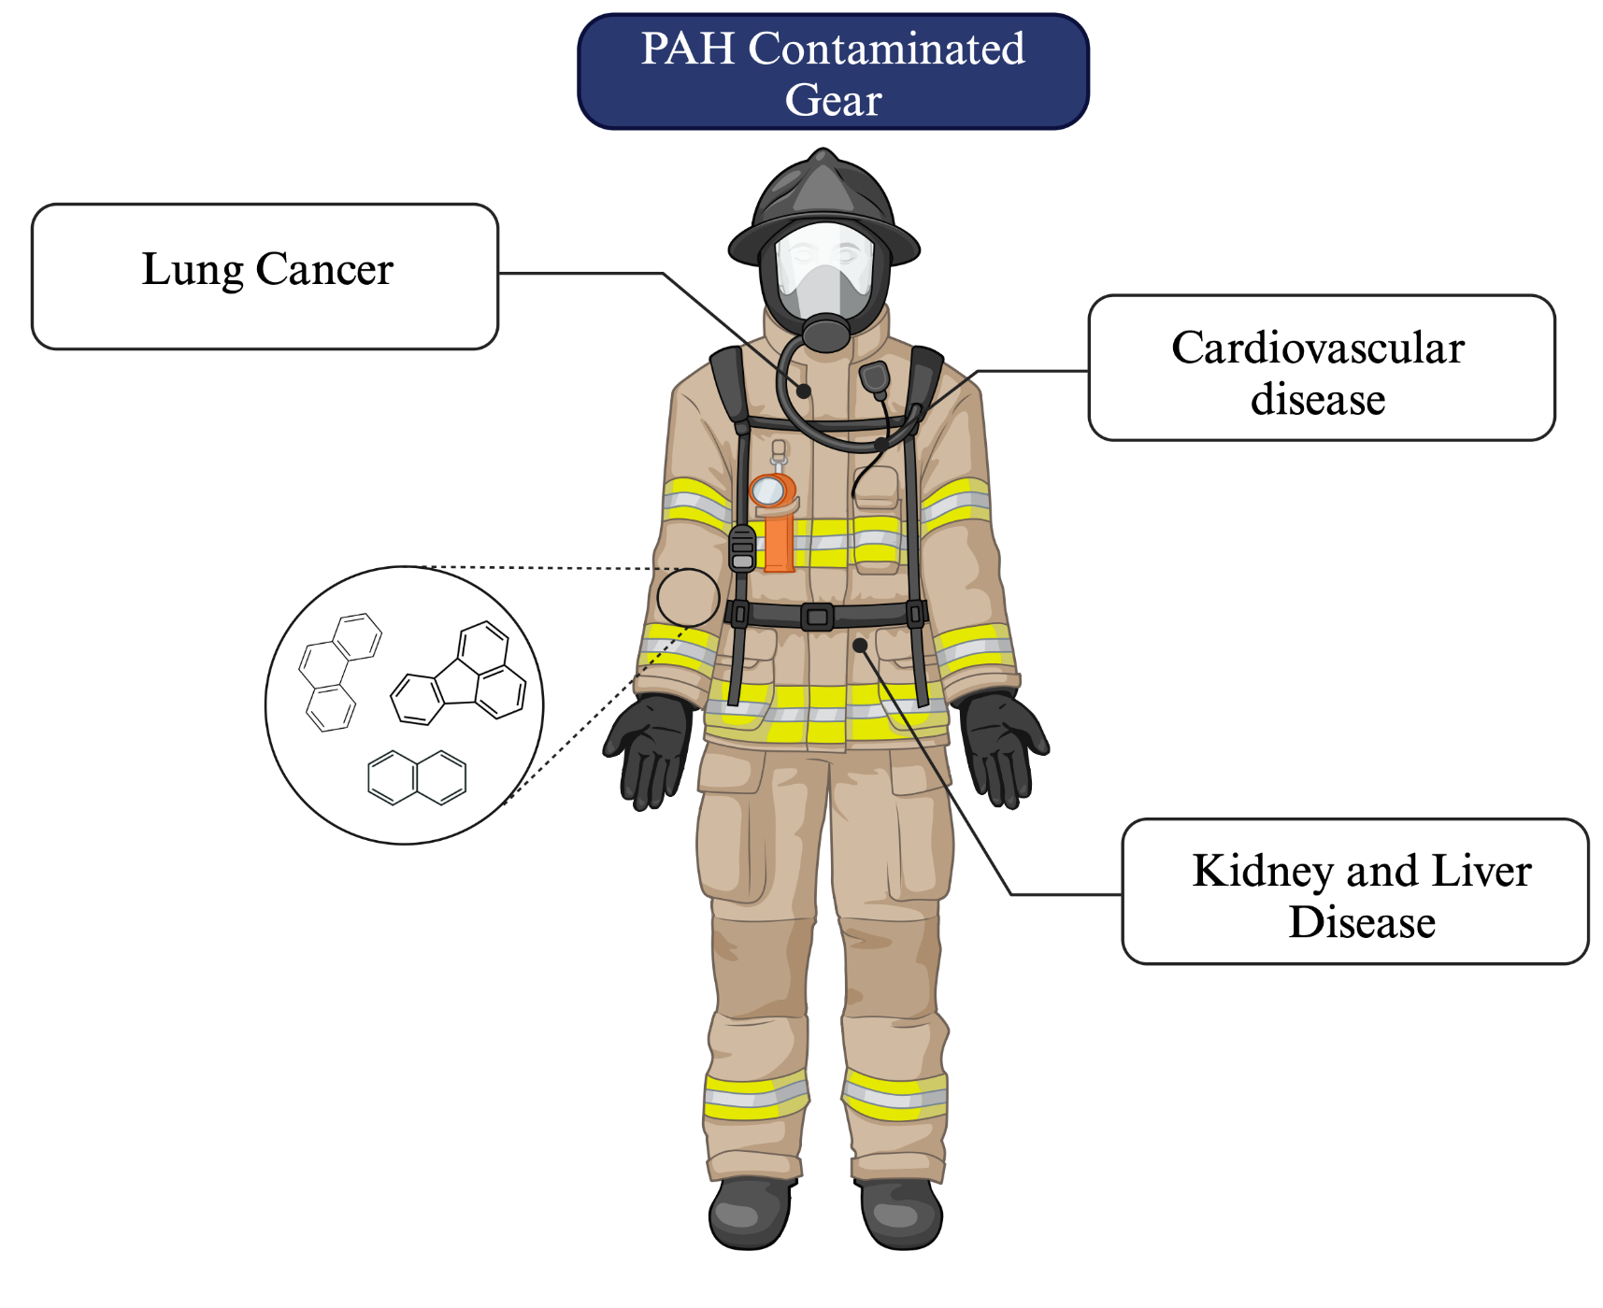
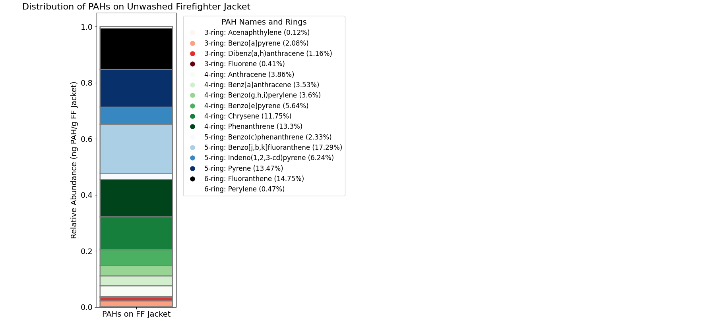
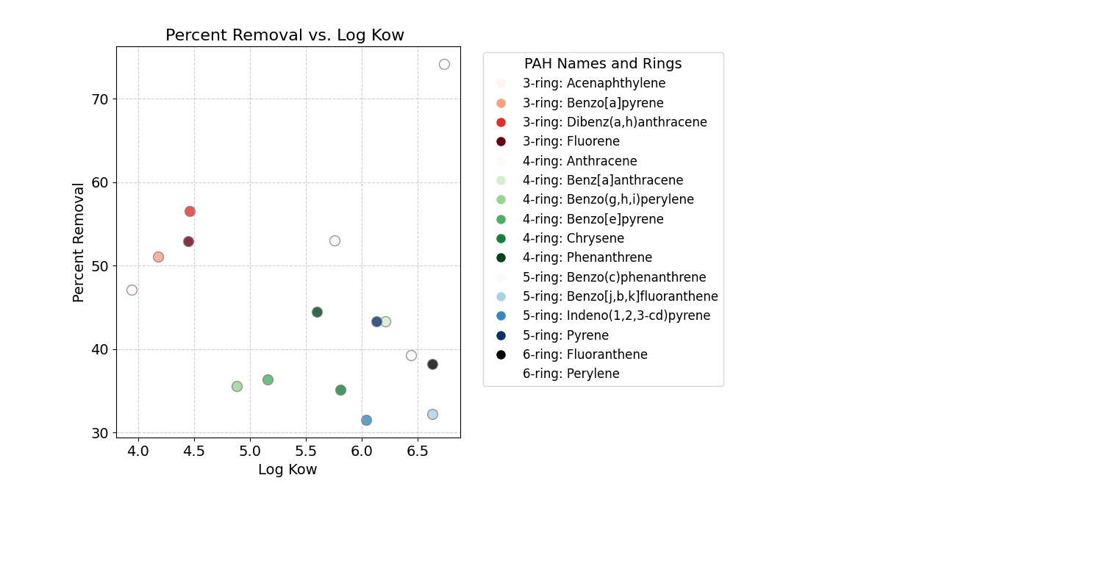

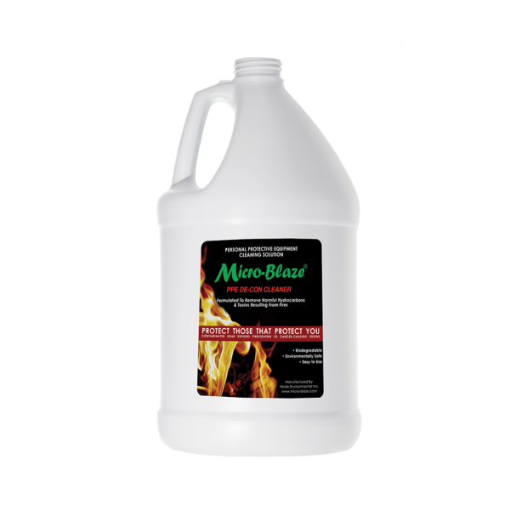
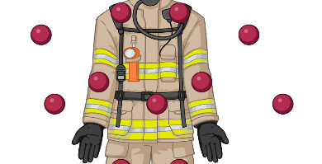
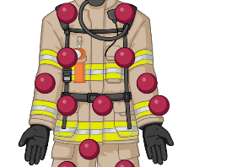
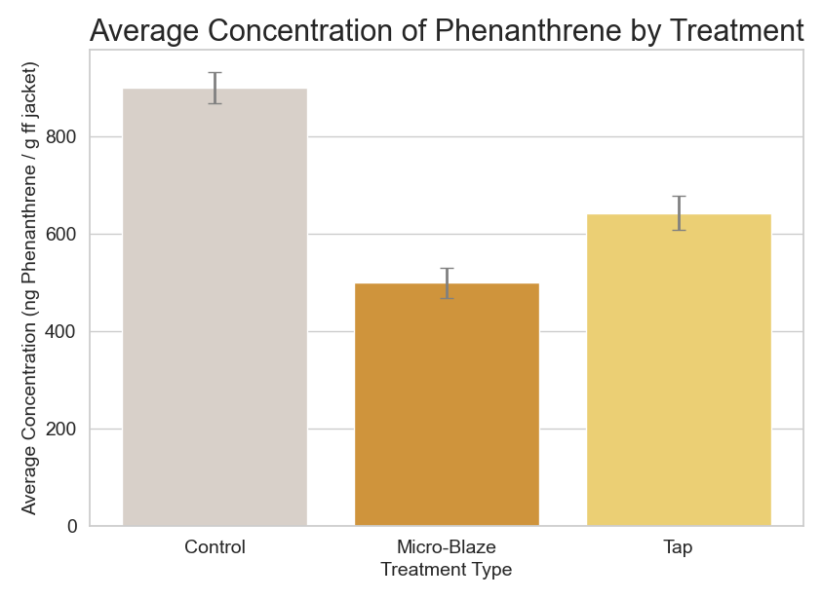
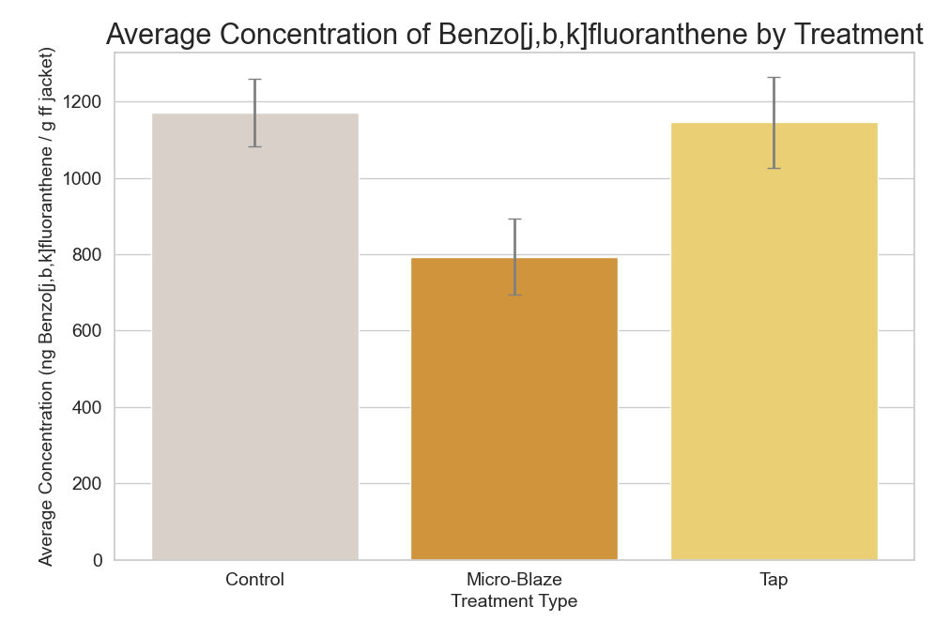
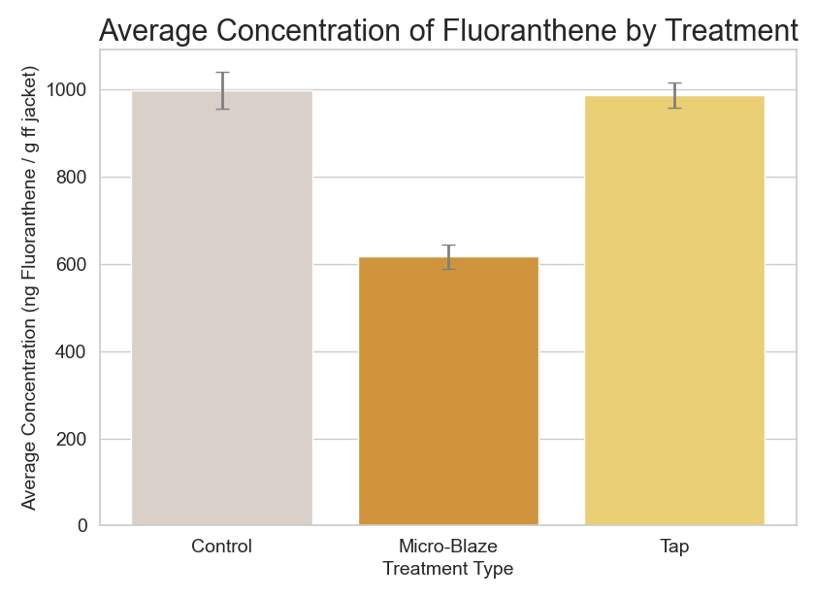
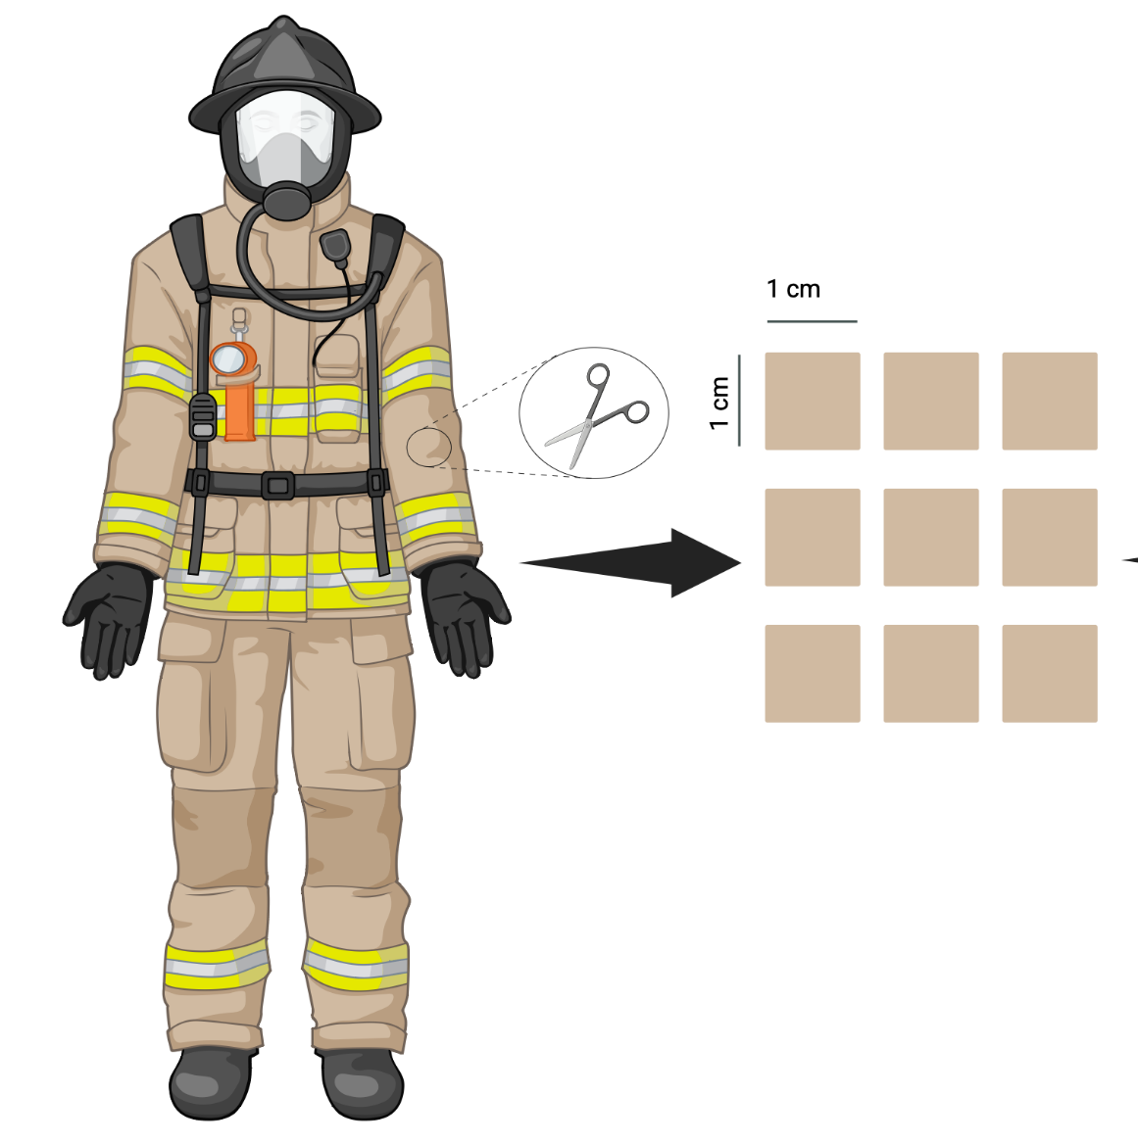

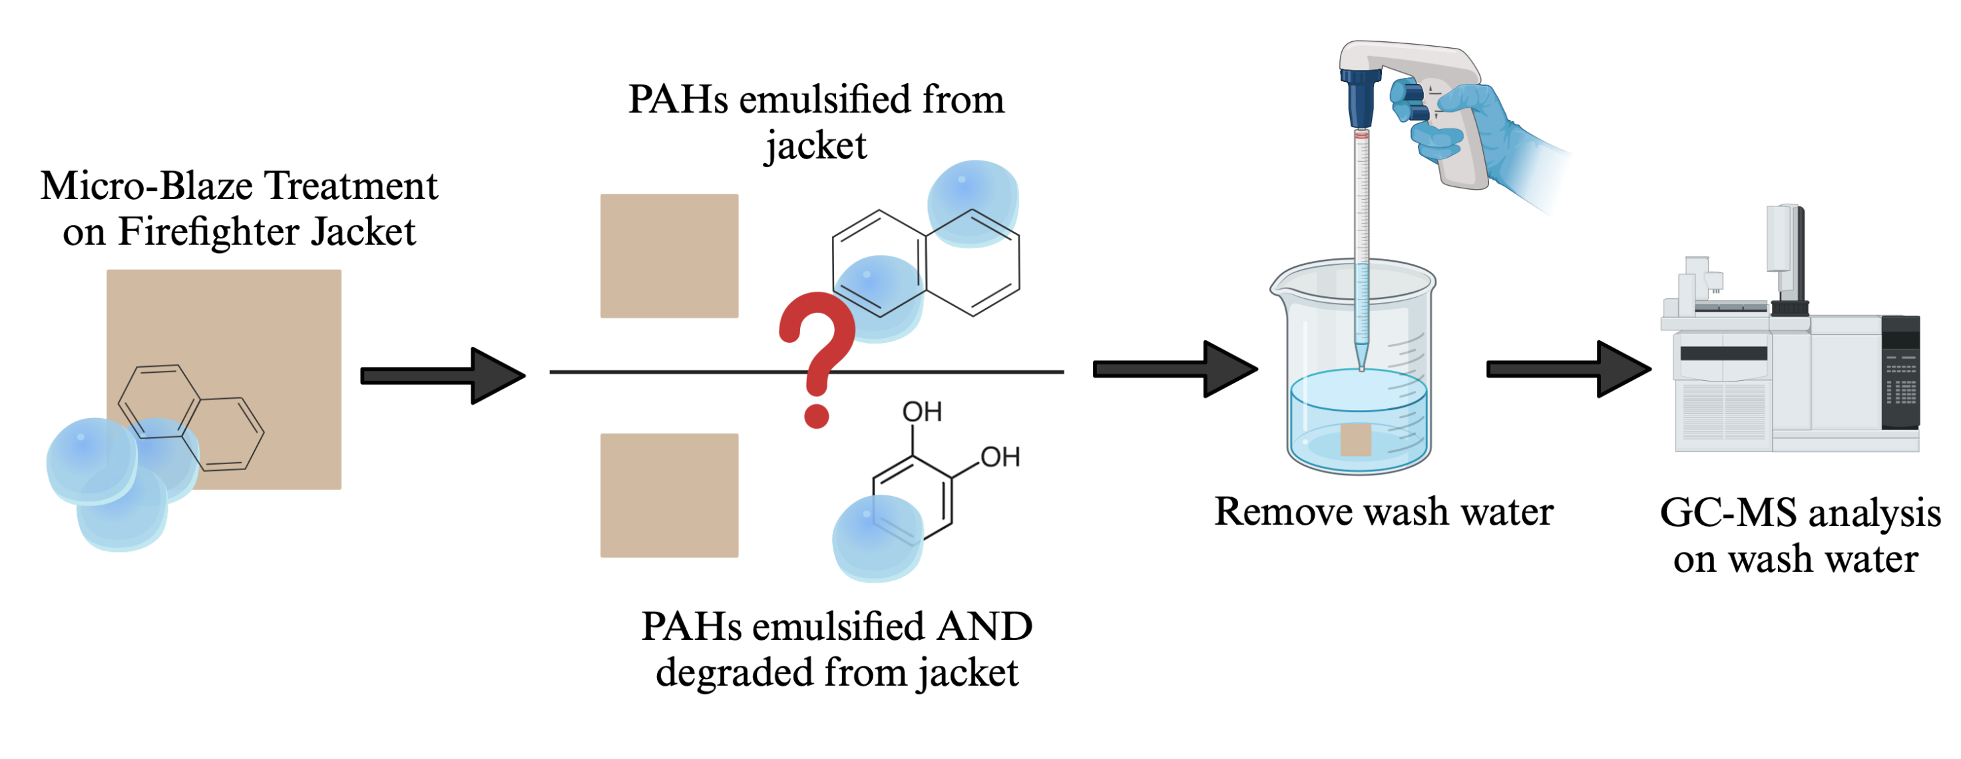
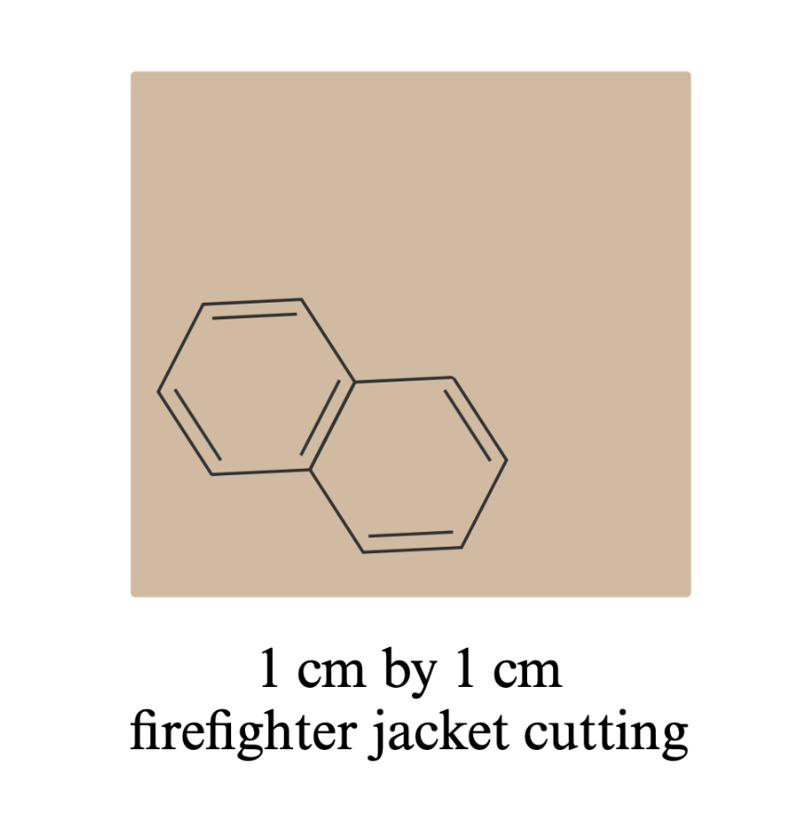




Testing the Efficacy of Micro-Blaze Detergent on PAH Removal from Firefighter Uniforms
Erica Babusci¹, Claudia K. Gunsch¹, and Heather Stapleton²
Department of Civil and Environmental Engineering, Duke University
Nicholas School of the Environment, Duke University
D u k e
U N I V E R S I T Y
614-600-6861
Erica.babusci@duke.edu
A
Background
Results For Micro-Blaze Treatment
Polycyclic aromatic hydrocarbons (PAHs) are a group of harmful chemicals that have carcinogenic and mutagenic properties.^{1,2,4} These compounds are formed through the partial combustion of organic material and accumulate on firefighter PPE, leading to long-term exposure and posing serious health effects.¹ Micro-Blaze PPE DE-CON Cleaner (MB) is a product marketed as a spore-containing detergent that not only removes the PAHs but degrades them into nontoxic byproducts.³
B
A
Figure 1: Overview of PAH exposure and effect on PAHs
This project aims to investigate the efficacy of this product for decontaminating firefighter PPE. Using cuttings from a used firefighter jacket and different treatment types, the project investigates the efficacy of using Micro-Blaze DE-CON cleaner to remove and degrade PAHs from the firefighter jacket.
Figure 2: Micro-Blaze PPE DE-CON cleaner
Figure 5 (A-B): Figures depict the chemical composition of the PAHs and how the chemical properties of different PAHs affect removal efficiencies. A: Bar plot looking at relative abundance of each PAH on the control jacket. B: Scatterplot depicting how the percent removal of each PAH is correlated to their respective log Kow. Percent removal is calculated by dividing the Micro-Blaze concentrations to the control/unwashed concentrations
Objectives
A
a
B
C
s
Evaluate the effectiveness of Micro-Blaze treatment compared to tap water and standard detergents in removing PAHs from firefighter gear.
c
a
a
b
Methods
Sample Preparation
A section from the arm of a firefighter jacket was provided from the Stapleton lab. Samples of 1 cm by 1 cm were cut and used for each experimental group in triplicate.
Treatments
Cuttings were exposed to one of the following wash treatments:
Control (no treatment)
5% Micro-Blaze³
5% Tide
Tap water
Wash steps involved 10 mL of wash liquid in a 50 mL beaker and left at room temperature on a plate shaker at 100 rpm for 1 hour.
Data Acquisition
Samples were then air-dried and packaged to be returned to the Stapleton lab for PAH extraction and GC-MS analysis.
Figure 6 (A-C): Figures are depicting the different in mean PAH concentration between treatment groups. A looks at Phenanthrene (4 rings), B looks at Benzo[j,b,k]fluoranthene (5-rings), and C looks at Fluoranthene (6-rings). Shapiro Wilks test was used to test normality. Fluoranthene was determined to be non-parametric, and a Kruskal-Wallis test was used to test significance. ANOVAs were used for Benzo[j,b,k} fluoranthene and Phenanthrene. Groups with p values < 0.05 were determined to be significant. This trend was seen for 14/16 PAHs
Future Directions
References and Acknowledgements
Analyze PAH extractions of the wash water to determine if compounds are being degraded or emulsified
[1] Kim et al. (2013) Environment International [2] Baxter et al. (2014) J Occup Environ Hyg [3] Verde Environmental, Inc (2025) Micro-Blaze Products [4] Seo, J.-S., Keum, Y.-S., & Li, Q. X. (2009). Bacterial Degradation of Aromatic Compounds.
Figure 3: Schematic of firefighter cuttings
This material is based upon work supported by the National Institute of Environmental Health Sciences Under Grant No. P42ES010356
Figure 4: Experimental groups tested for the study
Figure 7: Experimental design for future work exploring PAH removal pathways.

